Slide 1
Super Fast Automated Emulsion Scanning System
~ HTS ~
Masahiro Yoshimoto,
Toshiyuki Nakano and other HTS collaboration
Nagoya University, Japan

Slide 2
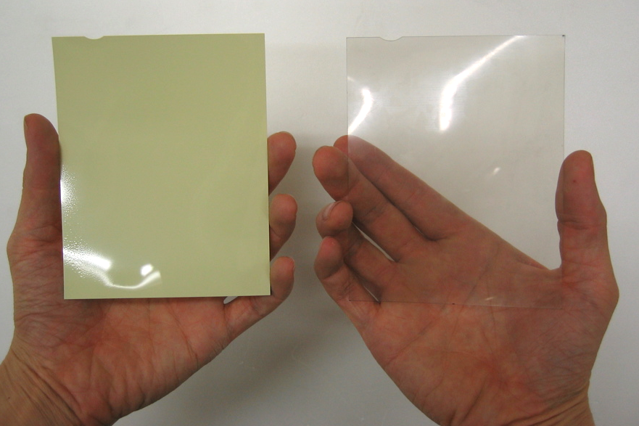
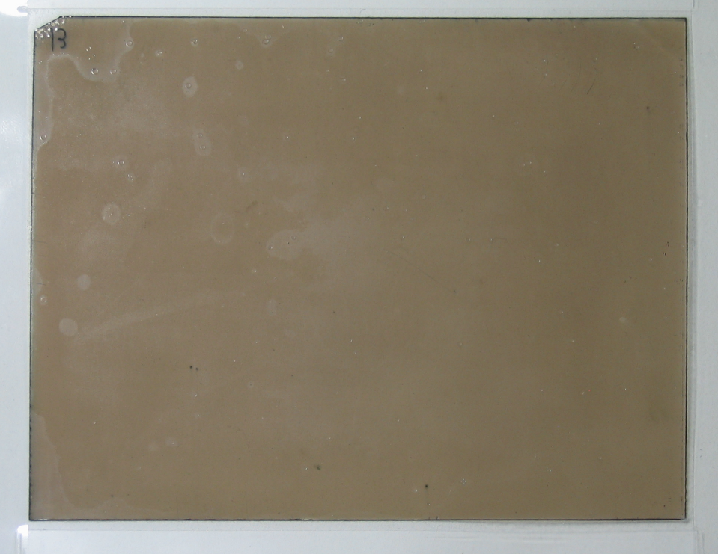
Our Emulsion Film
OPERA film
New Emulsion film (After development)
Before development
After development
12.5cm×10.0cm
In Nagoya Univ., We have been developing new emulsion film.
Grain density is much higher.
Emulsion gel can be produced by ourselves.
Pouring (coating) facility is under construction.

Slide 3
Detecting ionizing particles
Image sensor
Charged particles
Objective lens
Emulsion layer
Plastic base
Automated stage
Emulsion plate
Emulsion layer
Condenser lens
Kohler illumination
Light source

Slide 4
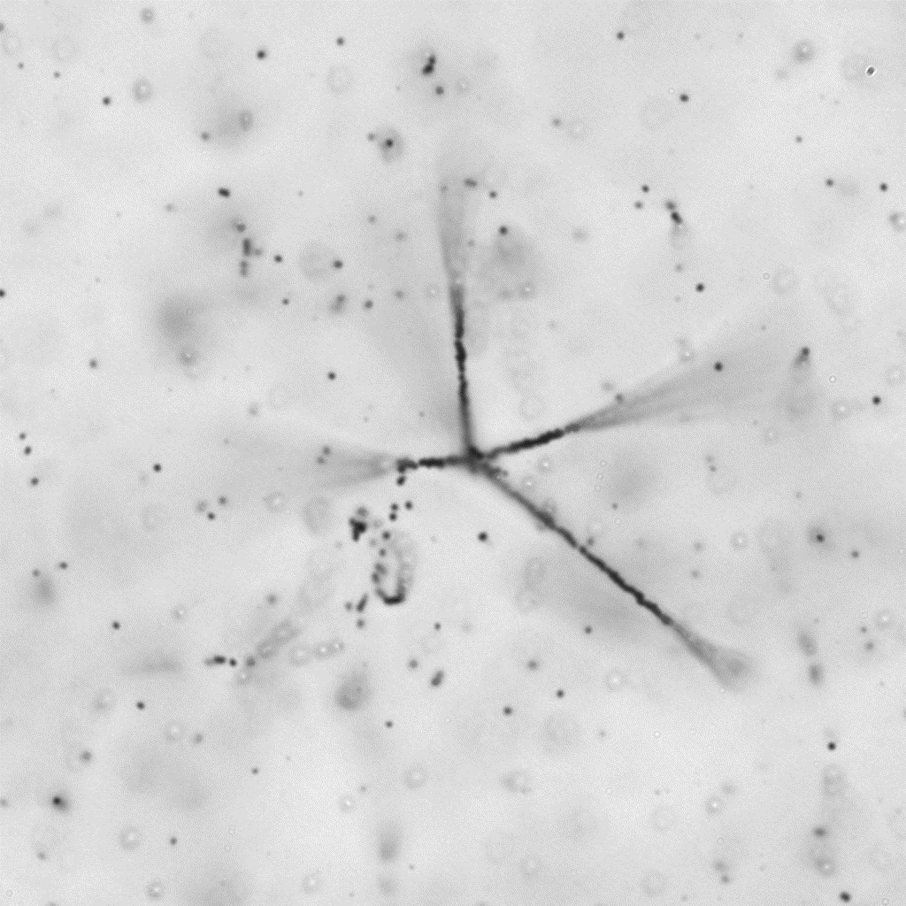


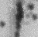
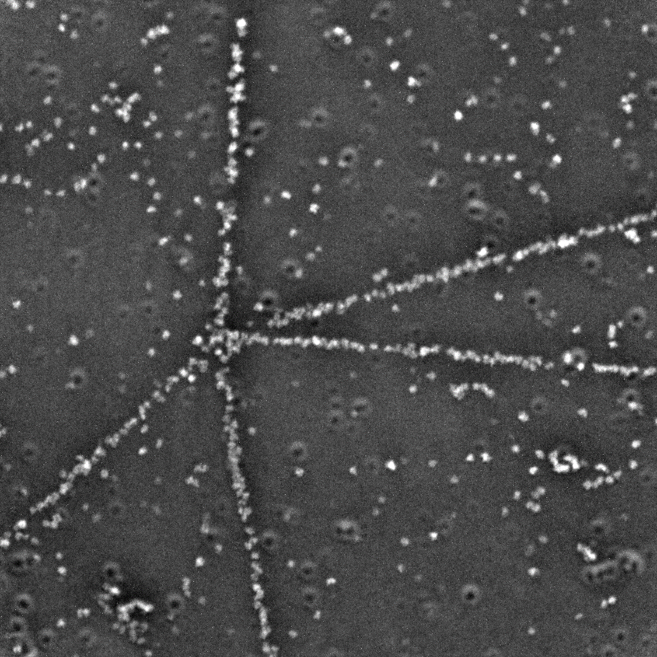

Capturing Emulsion Image
α-ray track
OPERA film
Thickness of the emulsion layer >50μm
Depth of field ~3μm
Size of the silver grain ~0.3μm
Optical resolution which is required <0.5μm
out focus
Z
in focus
out focus
1μｍ
1μｍ
Stacked image of optical microscope
res. 0.27μm
Image of X-ray microscope
DOF is ±~70μm
res. 0.07 μｍ

Slide 5
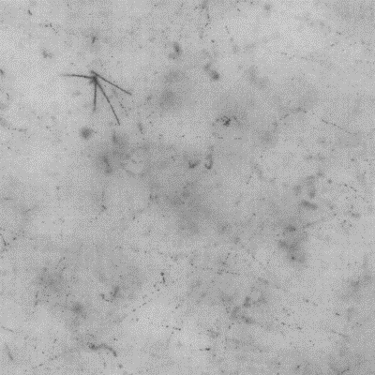

Image processing
Raw image which is taken

Slide 6
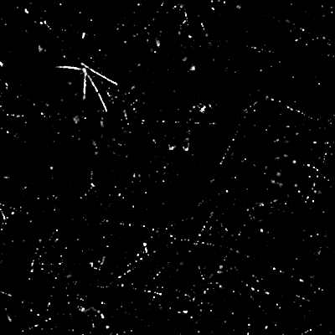

Image processing
Applying 2D-FIR filter
Cut off the background

Slide 7
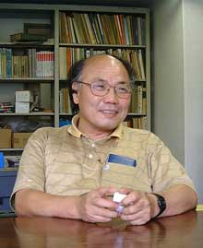
Track recognition method
Take 16 tomographic images by microscope optics.
Shift images to aim at specific angle tracks.
Sum up 16 images to examine coincidence.
Find signal of tracks.
Repeat for all angles in space, >2000 times
Invented by K. Niwa in 1974

Slide 8
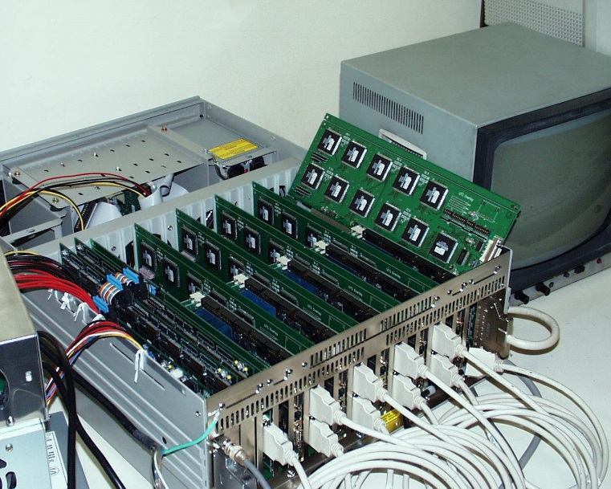
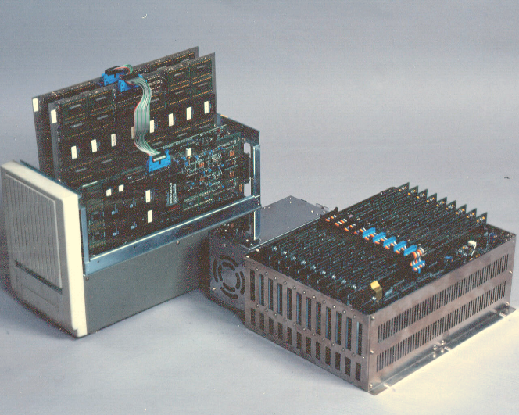
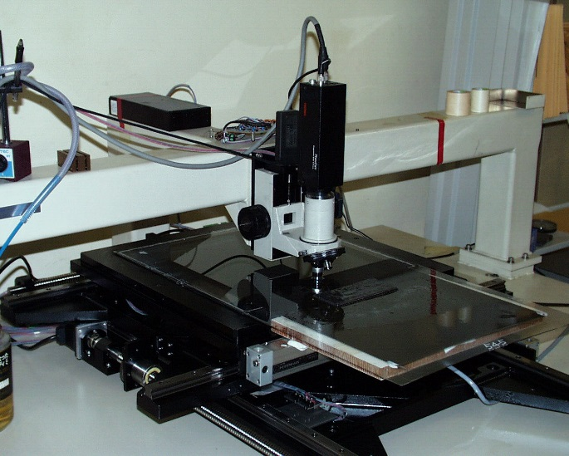
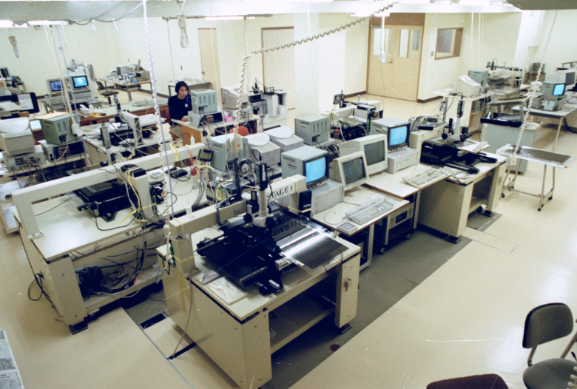
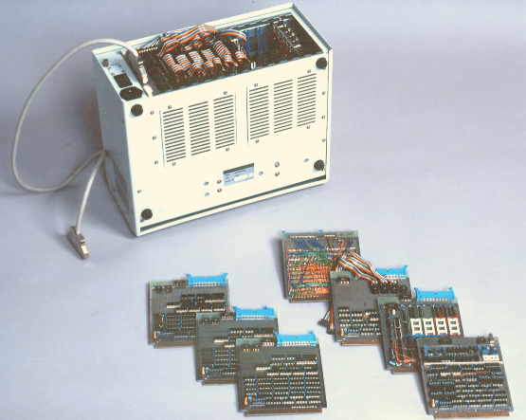
History of emulsion readout system in Nagoya
UTS (FPGA) 1998~
DONUT
1cm²/h
NTS (CPLD) 1994~
CHORUS
0.082cm²/h
TS (TTL)
1983~
CHORUS(R&D)
0.003cm²/h
Innovation has been required for the next generation systems.

Slide 9
Evolution of the Scanning Speed
Speed in cm²/ hour
10000
1000
72
100
10
1
1
×100
0.082
0.1
0.01
0.003
0.001
TS(TTL)
1983
NTS(CPLD)
1994
UTS(FPGA)
1998
S-UTS
(FPGA)
2006-
Running

Slide 10
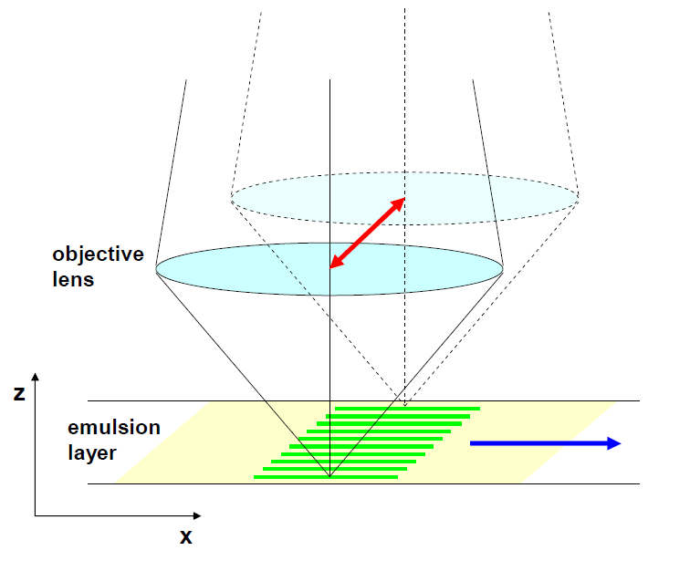
Overcome the Bottle necks of the image acquisition
Use Ultra High Speed Camera
  Up to 3k frames per second.
  60 view/sec (20times)
Image taking by follow shot
  No step and repeat operation can avoid a mechanical bottleneck.
  High speed motion of the objective lens can be done by piezo actuators
Optimizing Field of View
  120mm×90mm -> 200mm×200mm (4 times)
We have achieved 72cm²/h

Slide 11

Movie of the readout by S-UTS
S-UTS

Slide 12
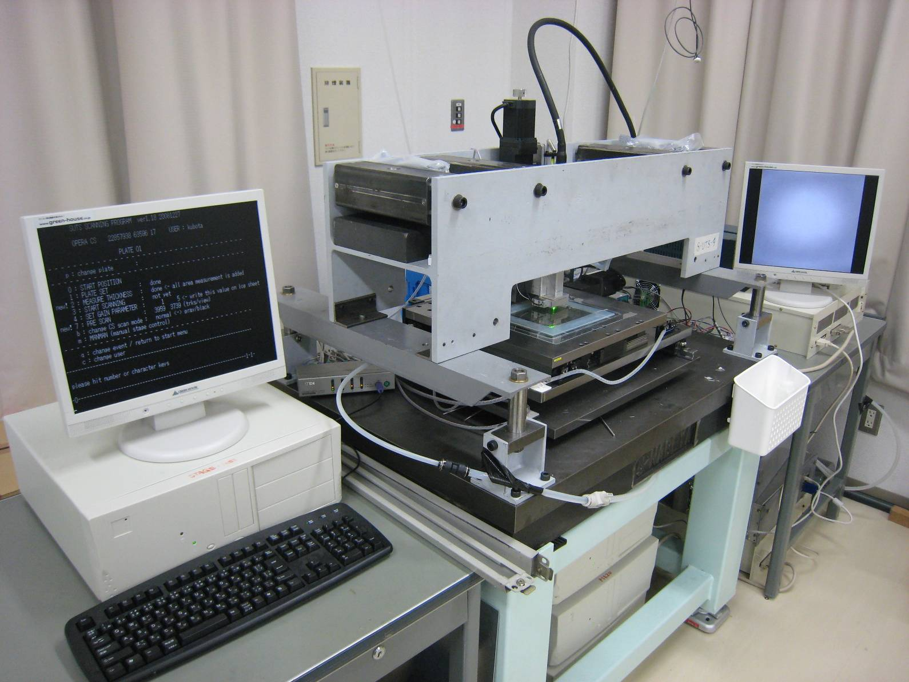
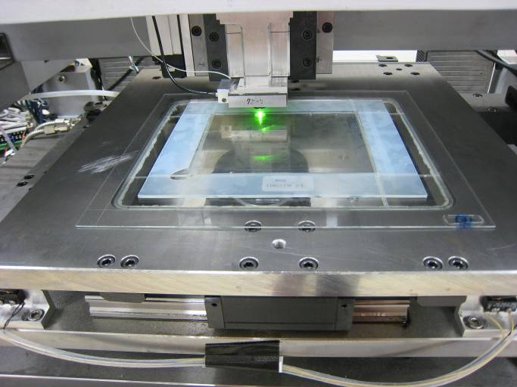
S-UTS (Super-Ultra Track Selector)
Five S-UTSs were produced in order to perform OPERA experiment.
Readout capability of one S-UTS is 20m²/year.

Slide 13
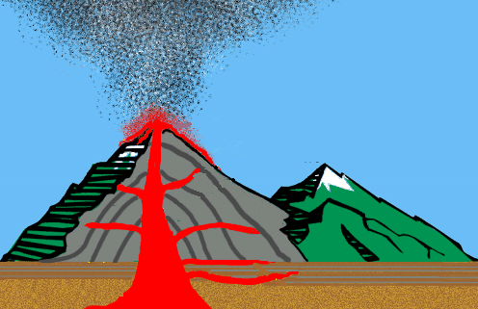
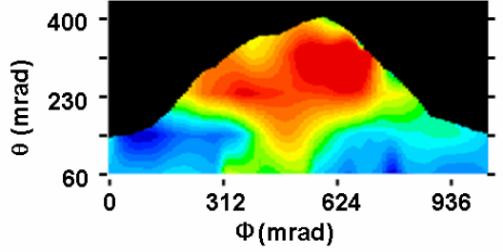
Applications of Nuclear Emulsion
・・・・・ need much more speed !
Muon Radiography
cosmic ray muon
100m² will be required for one measurement.
→Morishima’s talk

Slide 14
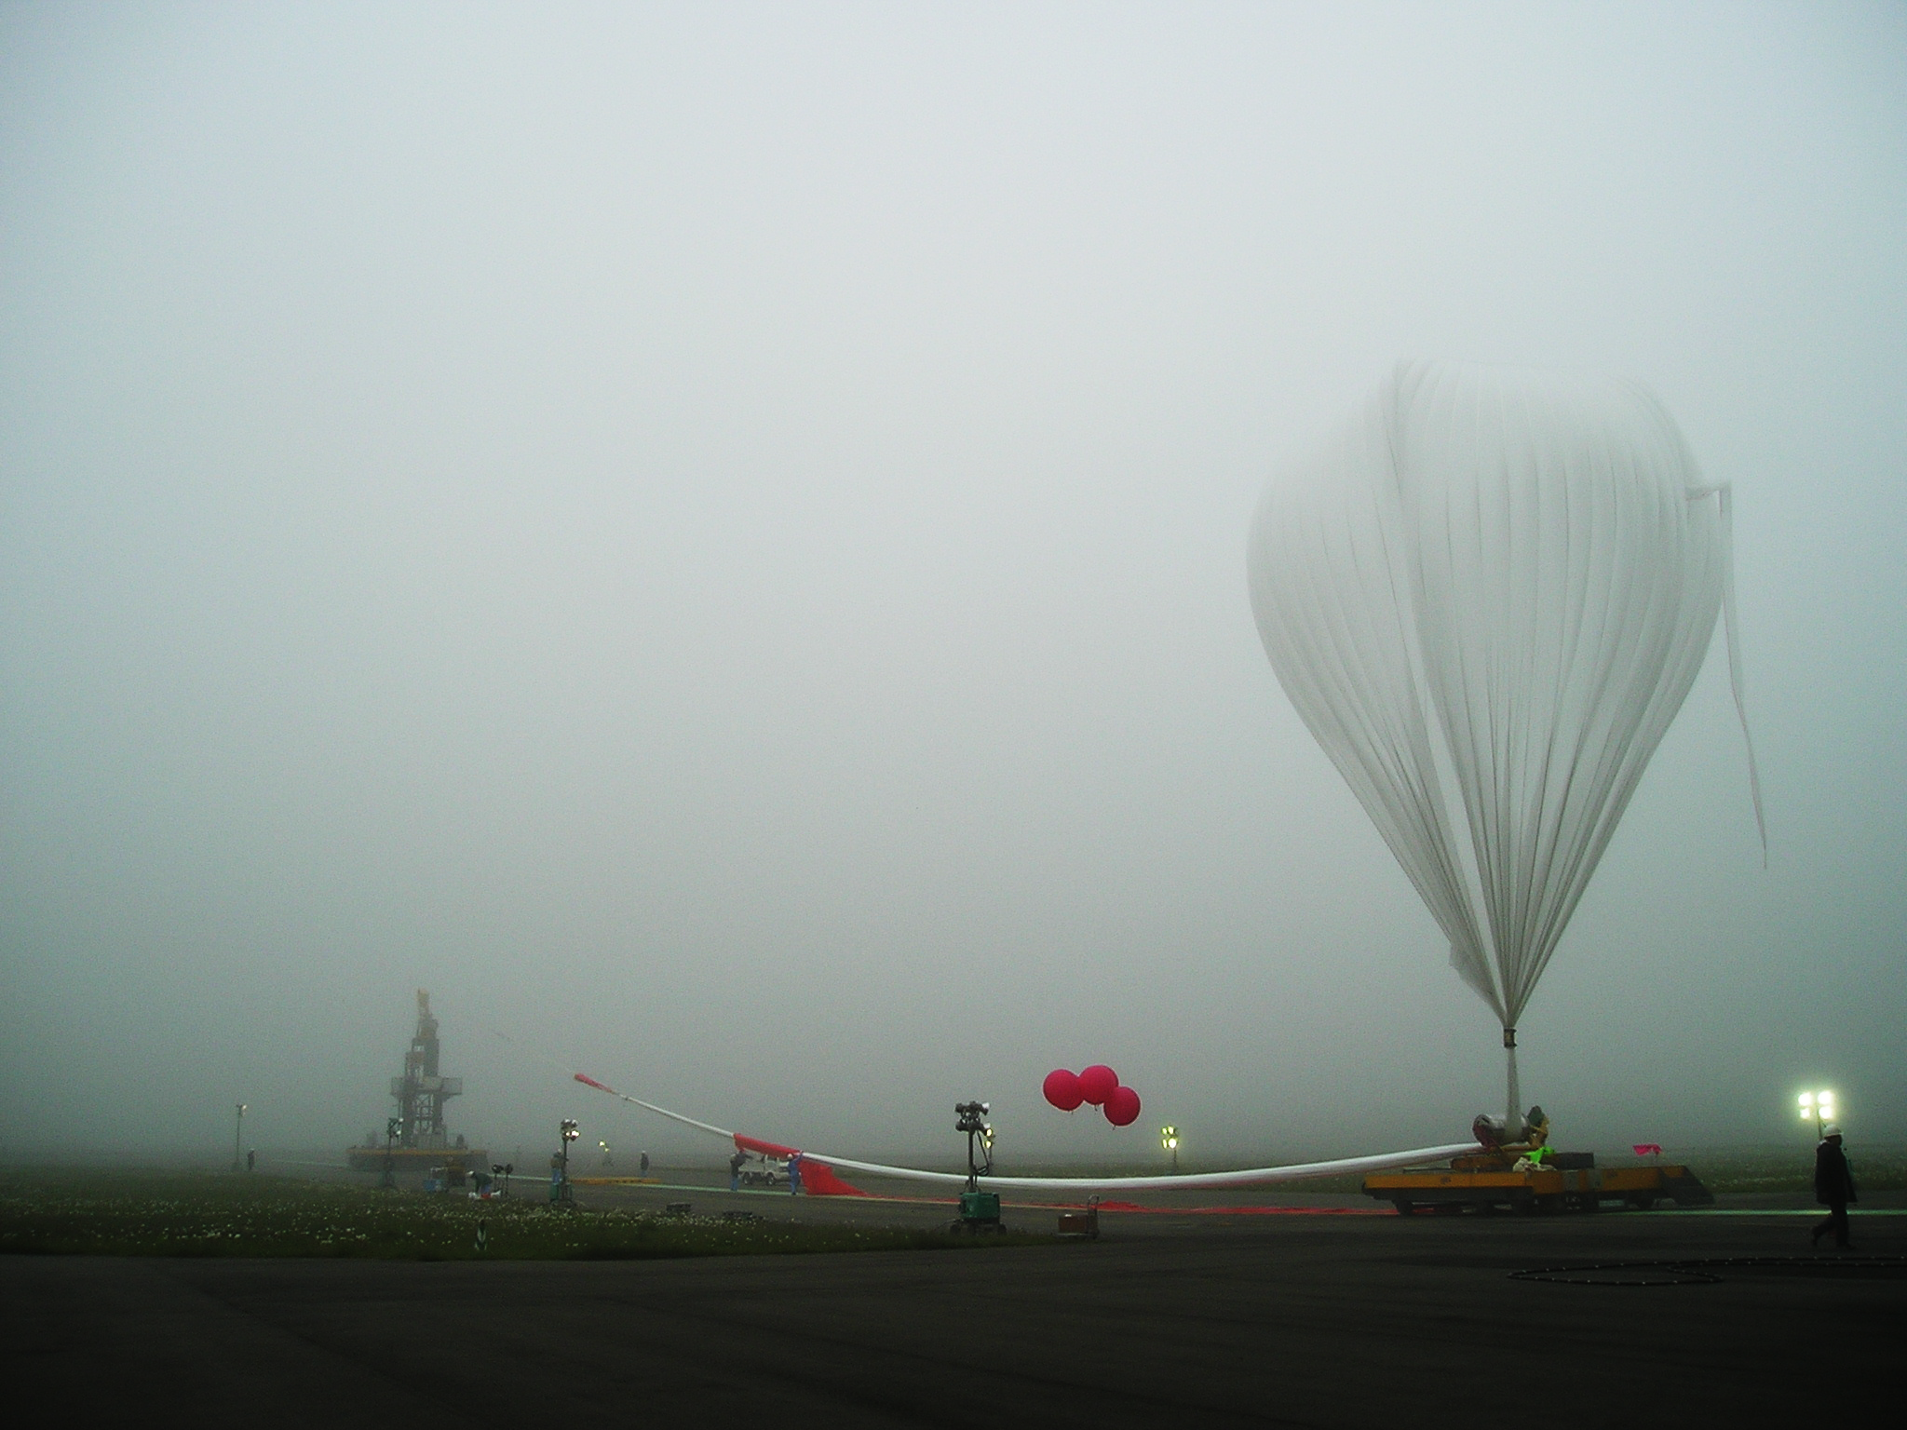
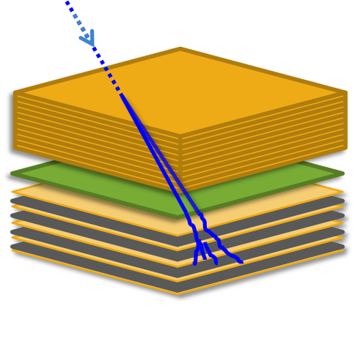
Applications of Nuclear Emulsion
・・・・・ need much more speed !
GRAINE project
Gamma-ray Telescope
Several 1000m² will be required for scientific observation.
γ
Converter
e⁺
e⁻
2011 Balloon experiment was performed.
2014 Planned at Alice Springs.
2015- Starting scientific observation
Timestamper
Calorimeter
Attitude monitor

Slide 15
Applications of Nuclear Emulsion
・・・・・ need much more speed !
Dark Matter Search
NIT
Earth
Dark Matter
Sun
F.L.～ 200nm
230km/sec
WIMP
Recoil atoms
crystal Ag,Br,I
gelatin H,C,N,O,S
V_{recoil} = 2 ( V_{sun} + V_{WIMP} )
= 100～1000km/sec
We need to readout the target mass of 1 ton (about 4000m²).
→Asada’s talk
~3g / film
0.0125m²/film

Slide 16
Evolution of the Scanning Speed
※1 Area of each layer
※2 Area of the films
※2
Speed in cm²/ hour
~2000m²/year
9000
※1
10000
1000
~20m²/year
72
100
×100
10
1
1
0.082
0.1
0.01
0.003
0.001
TS(TTL)
1983
NTS(CPLD)
1994
UTS(FPGA)
1998
S-UTS
(FPGA)
2006-
Running
HTS
(GPGPU)
2011-
Developing

Slide 17
Concept of HTS (Hyper Track Selector)
It is difficult to drive objective much more quickly.
Field of view can be a few orders of magnitude larger.

Slide 18
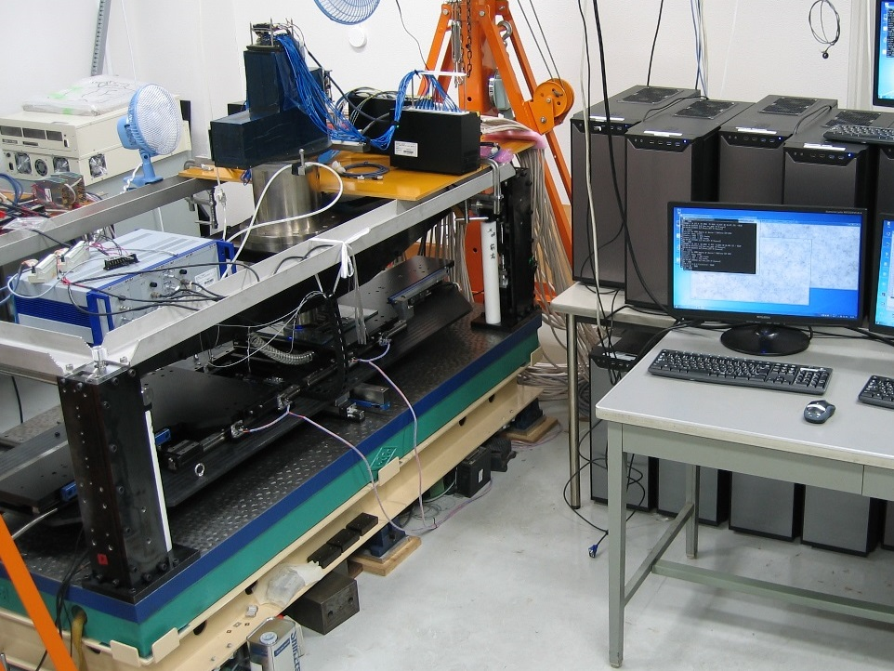
HTS
Computer
GPU board
・Wide FOV optical system
Z
X
Y
・High precision and speed stage

Slide 19
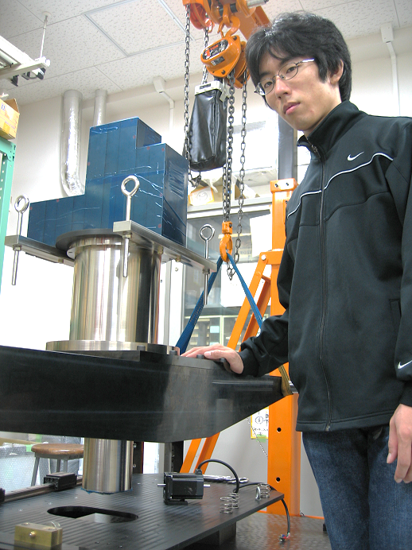
Enormous Objective
Resolution : ~420nm
N.A. : 0.65
Light source : g-line (436nm) Magnitude : ×12.2
F.O.V : 5.1 (H)×5.1 (V)mm
#of image plane 6
(by Beam splitter)
Weight : 80kg

Slide 20
Wide field of view
Field of view (FOV) of HTS
5mm
S-UTS
× 600
5mm
~0.2mm

Slide 21
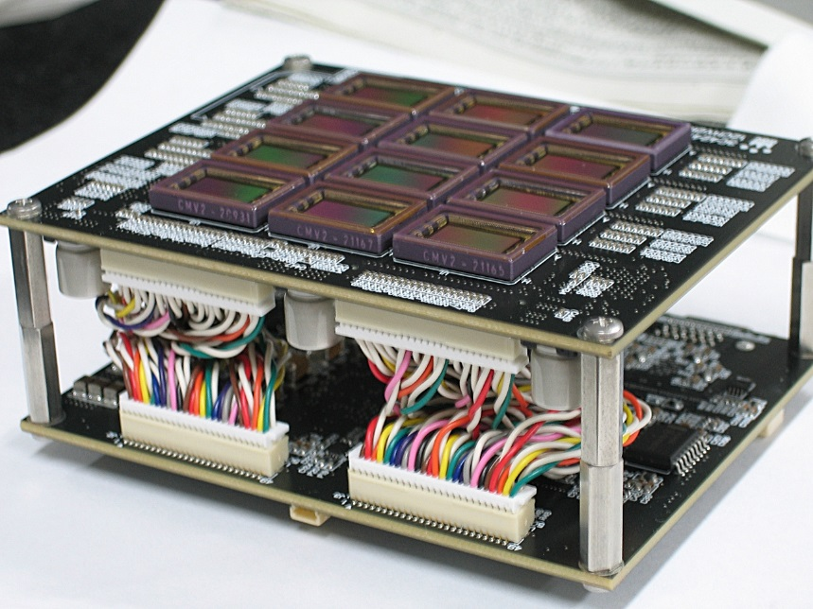
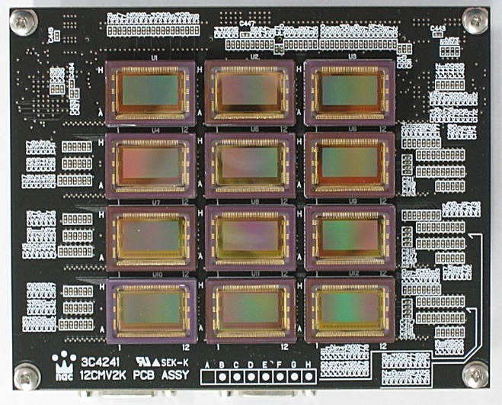
Speed and Coverage of Mosaic Imager
Divide FOV into 72 parts.
Need the sensor of 2M pixel and 340fps.
Specially ordered Mosaic Imager
5mm
5mm

Slide 22
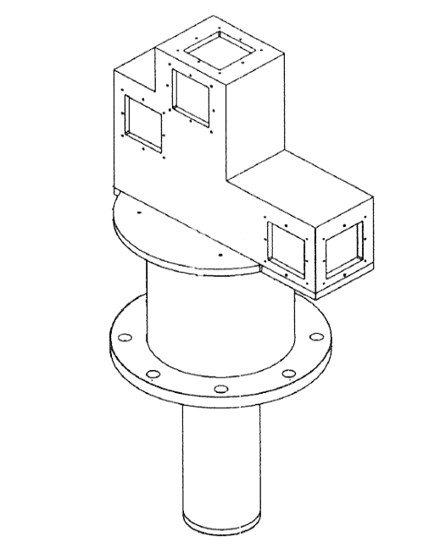
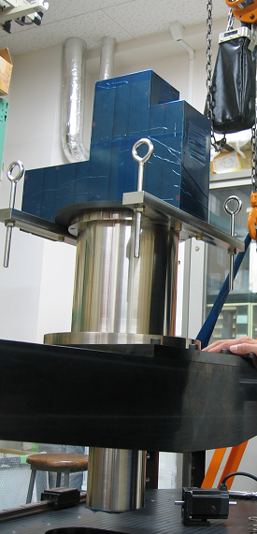
Mosaic Imager system
5
4
Beam splitter
Camera1
6
3
1
1
Camera2
2
Objective lens
Camera6
5mm
Illumination
5mm

Slide 23
Movie of the readout by HTS
HTS

Slide 24
Image capturing at rest
Stopping accuracy should be 0.3μm.
HTS takes advantage of Stop & Go in image capturing.
Key is how to stop quickly and precisely.
The Z-axis should move at constant velocity.
Throughput = FOV × Repetition freq.
FOV : 600 times larger
To achieve 100 times faster than S-UTS,
Repetition freq. should be >10view/s (1/6 of SUTS)

Slide 25
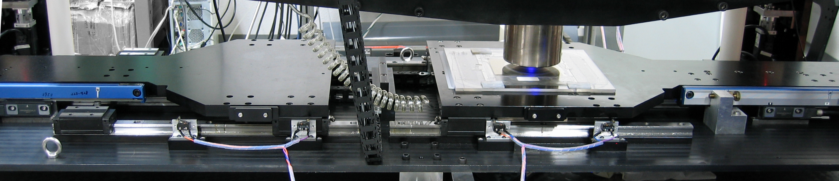
High precision and speed stage
Under developing
Counter Stage
Main Stage
Velocity
50cm/sec (Max. speed)
Moving mass : 34.7kg
Step dist. : 5.0mm
Acc. rate : 5G (50m/s²)
Acpt. vibration.: ±0.3μm
20ms
20ms
60ms
20ms
Time
drive
settle
capture (18frame)
100ms (10view/s)
Reaction force is canceled by counter stage

Slide 26
Evaluation of stage settling time
By optimizing the acceleration, 5view/sec was achieved.
The displacement has been measured by using main optics.
0.50
±0.25μm
0.25
0
displacement [micron]
-0.25
-0.50
-0.75
settle
17ms
capture
60ms
-1.00
-1.25
drive 120ms
msec

Slide 27
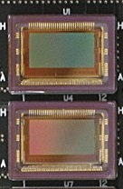
Tracking Hardware
Sensor 72 × 36Mbyte/view × 10view/s ＝ 26GB/s
Computer 36, Frame grabber board 72, GPU board72
Sensor
Computer
360MB/s
Frame Grabber
GPU
CPU
360MB/s
Frame Grabber
GPU
26GB/s/all
2.6TB/plate (OPERA film)
×36

Slide 28
Dataflow
Amount of data
per sensor per view
Processing time
Synchronous
Sensor
Raw Image
36MB
Total is less than 100ms
Image filter
pixel count
GPU 15~50ms
Binarized Image
5MB
GPU 20~50ms
depend on the angle range.
Track recognition
All track
5MB
Asynchronous
Clustering
CPU 100~200ms
Micro Track
~0.3MB
Storage Server

Slide 29
Stage control
Feedback Pixel count for surface detection
2Sensor & 1Computer
Image Capture &Tracking
6MB/s
Master Computer
Storage Server
10G Ether
RAID DISKs
Stage controller
・Motor (8 axis)
・Piezo (3 actuator)
・・・
10G Ethernet Switch
Image Capture &Tracking
Storage Server
Broadcast stage position, actuator status and Trigger timing for image capture
×36
ave. 200MB/s/all
~10GB/plate

Slide 30
Scanning speed and other status
December 2011 Objective lens and beam splitter were mounted.
May 2012 All motors for xyz-axis drive began to work.
November 2012 Piezo actuator for z-axis drive was installed.
May 2013 Half of cameras and computers became ready.
May 2013~ Scanning test for various emulsion plates
 | Practicable | Installed | Final Goal
Stage | 2 view/s | 5 view/s | 10 view/s
Camera | 1 unit | 3 unit | 6 unit
Speed | 300cm²/h | 2250cm²/h | 9000cm²/h
cf. S-UTS 72cm²/h
I did scanning test at this speed.

Slide 31
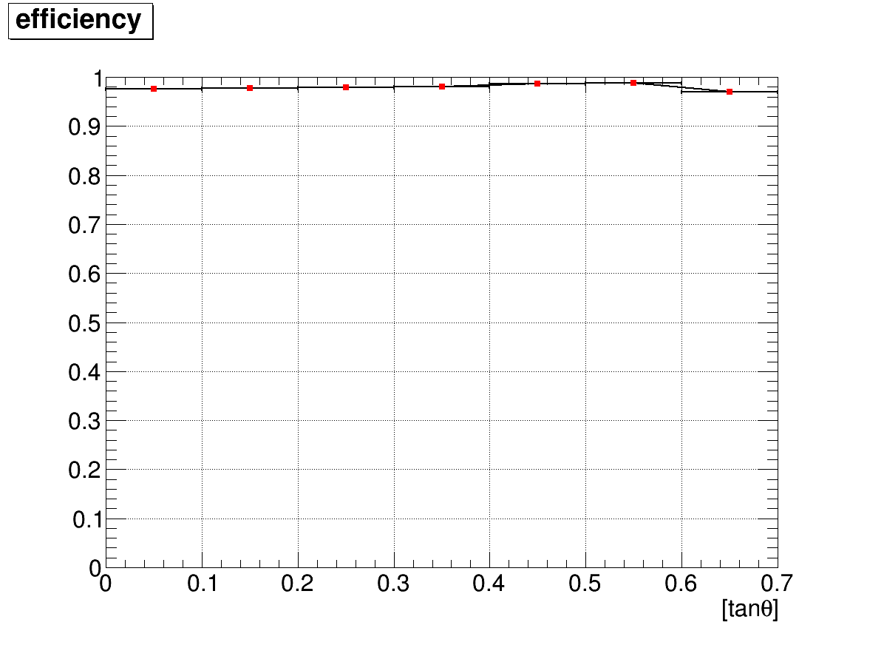
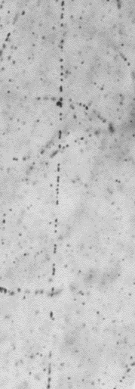
New Emulsion Film
PL13
？
Exist or not
HTS
PL11
New type
preliminary
Efficiency 98.0%
18,264track / 18,632track
tanθ < 0.6
cf.
S-UTS 98.3%
10
20
30
[deg]
GD=51.6+-2.6
FD=3.3+-0.4

Slide 32
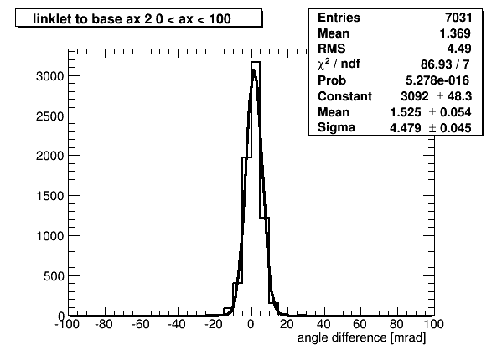
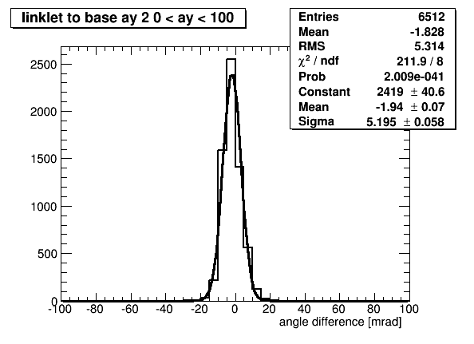
New Emulsion Film
PL13
δθ
prediction
Angle deviation
PL11
Sigma
4.5mrad
Sigma
5.2mrad
preliminary
X-projection
Y-projection
cf. S-UTS
4.8mrad
cf. S-UTS
4.3mrad

Slide 33
What we can do with HTS?

Slide 34
Emulsion Archives Project
The project is to read all emulsion and convert to the data.
In near future we will scan a lot of emulsion with HTS.
Requirement,
All Emulsion existing around the world.
Money (and man power) for running
Unified Specification of track and image
And
Dream for Science

Slide 35
Summary and Prospect
We are developing HTS which is 100 times faster.
Scanning at the speed of 300cm²/h is practicable.
The efficiency and angle resolution are almost the same as previous system.
HTS is working for muon radiography, GRAINE project and dark matter search.
All cameras and computers will be installed this year.

